Slide 1




GLOBAL CERT NUS ENTERPRISE
E-COMMERCE RETAIL ANALYSIS

Slide 2
LIST OF CONTENTS
01
INTRODUCTION
03
DATA EXPLORATION AND ANALYSIS
05
CONCLUSION
02
PROBLEM STATEMENT
04
INSIGHTS
06
RECOMMENDATIONS

Slide 3

INTRODUCTION
An e-commerce retailer is distinct from a traditional retailer. Normally, a buyer may examine and evaluate a product before purchasing. The client does not have the option to physically examine the product before making a purchase in an e-commerce ecosystem. The kind of goods that is sent to the consumer is beyond of their control.
Therefore, online retailer must sell the goods exactly as described in order to operate a successful online business.

Slide 4

PROBLEM STATEMENT
Customer attrition is a challenge that the client is dealing with in his online retail shop. The opposite of client retention is customer attrition. A company experiences customer attrition when consumers leave.
This is reflected by customer attrition, a phenomenon where the customer loses faith with the brand and moves out to the competitor brand. Customer attrition is measured by churn rate.
Customers Attrition also called Customers Churn.

Slide 5


EXPLORATORY DATA ANALYSIS
Data Cleaning
Data Processing
Univariate Analysis

Slide 6
Country Wise Analysis
Countries having the highest and least retail rate
INSIGHTS
After extensively performing EDA, we were able to discover patterns and relationships in data that we didn't know existed previously
Monthly and Weekly Analysis
Patterns in retail sale in months and weeks
Customer Analysis
Filtered out the most valuable customers

Slide 7
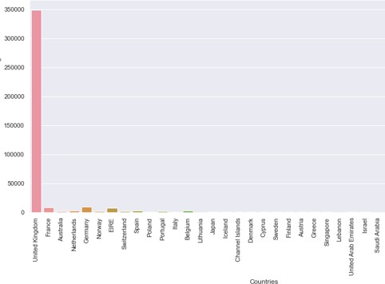
COUNTRY WISE ANALYSIS
We can see that UK is the country with the most number of retail rate by quite a huge margin
If we talk about countries other then UK, we can see that France, Germany & EIRE are the most considerable ones

Slide 8
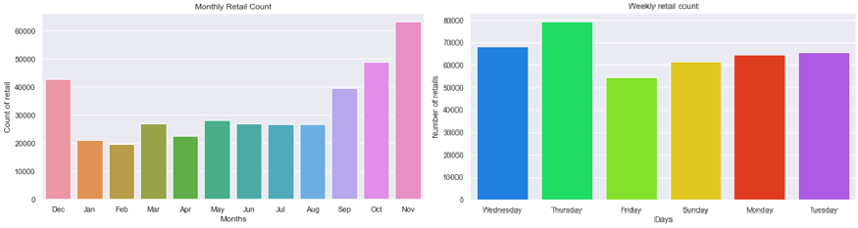
MONTHLY AND WEEKLY ANALYSIS
We can see that the sales are quite high between August till December and then decreases significantly in January and remains quite stable till August
This can be due to seasonal products, holidays, sales & discounts
We can also observe that the sales are comparatively high during weekdays rather then weekend

Slide 9
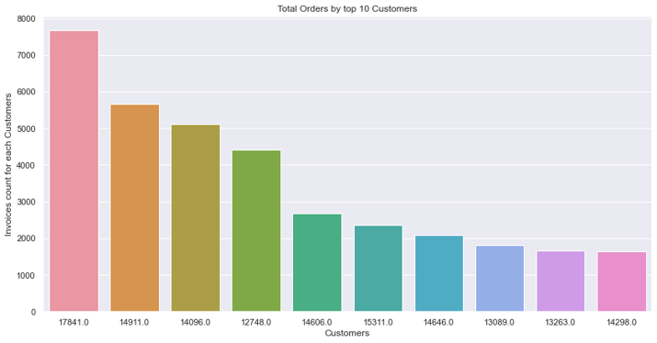
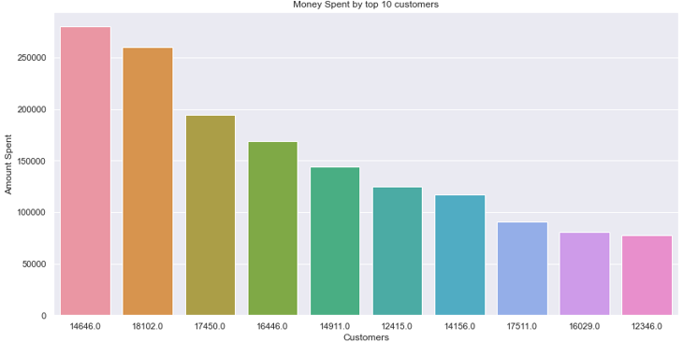
CUSTOMER ANALYSIS
In the first graph, we can see the top 10 customers that have made the most amount of purchases from our retail store
While in the second graph, we can see the customers that have spent the most amount of money
An interesting insight from these two graphs is that the customer with most number of purchases is not even in the list of top 10 customers who have spent the most amount of money

Slide 10

38,000
UK Sales
ID: 14646
Most Valuable Customer
NOV
Highest Sales
ID: 17841
Most Purchases
CONCLUSION

Slide 11
Better Customer
Service
Customer
Feedback
Promos &
Discounts
Digital Marketing
Recommendations

Slide 12
THANKS
FOR WATCHING

